Slide 1
Stock Analysis Dashboard Summary Comprehensive Financial Overview and Risk Insights
Prepared By : Jay Gopani
Date: 30/07/2025

Slide 2
Executive Summary
Covers performance of companies: Zorto, Maxp, Survelia, Jecco
Tracks total return, risk, and daily return metrics
Identifies trends over time and relative company positioning
Enables dynamic slicing and comparative analysis

Slide 3
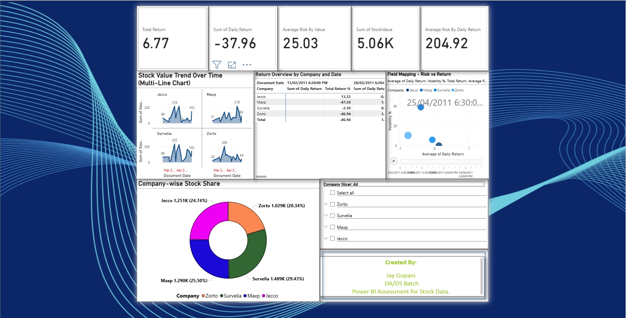

Slide 4
Key KPIs
Total Return
Sum of Daily Return
Average Risk by Value
Sum of Stock Value
Average Risk by Daily Return

Slide 5
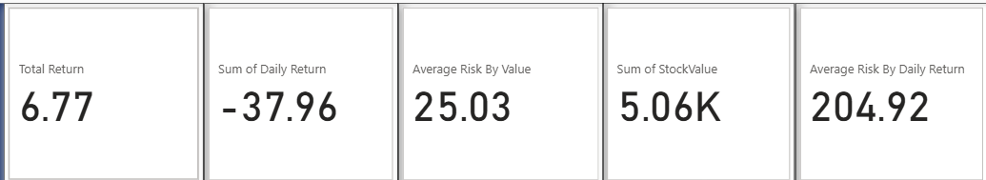

Slide 6
Trend Overview
Chart: Multiline chart with Small Multiples (Company-wise)
Insight:
Observe peaks and troughs in stock value movement
Compare trend strength and direction across companies

Slide 7
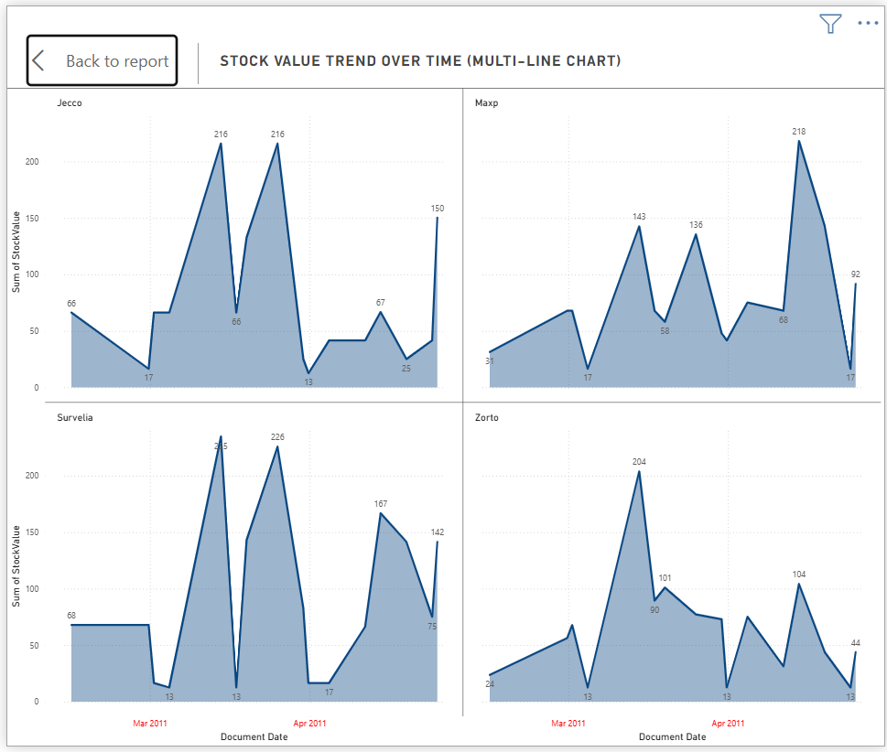

Slide 8
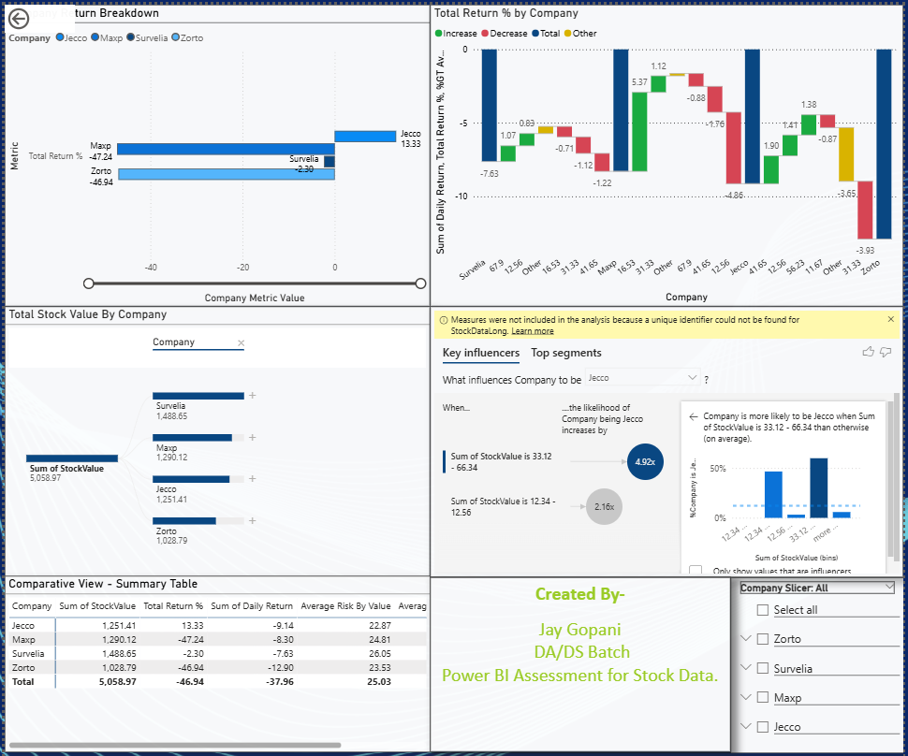

Slide 9
Risk vs Return
Chart: Scatter Chart
X-Axis: Average Risk
Y-Axis: Total Return
Size: Daily Return
Legend: Company
Insight:
Evaluates risk-return efficiency
Identifies outlier stocks with high return or high volatility

Slide 10
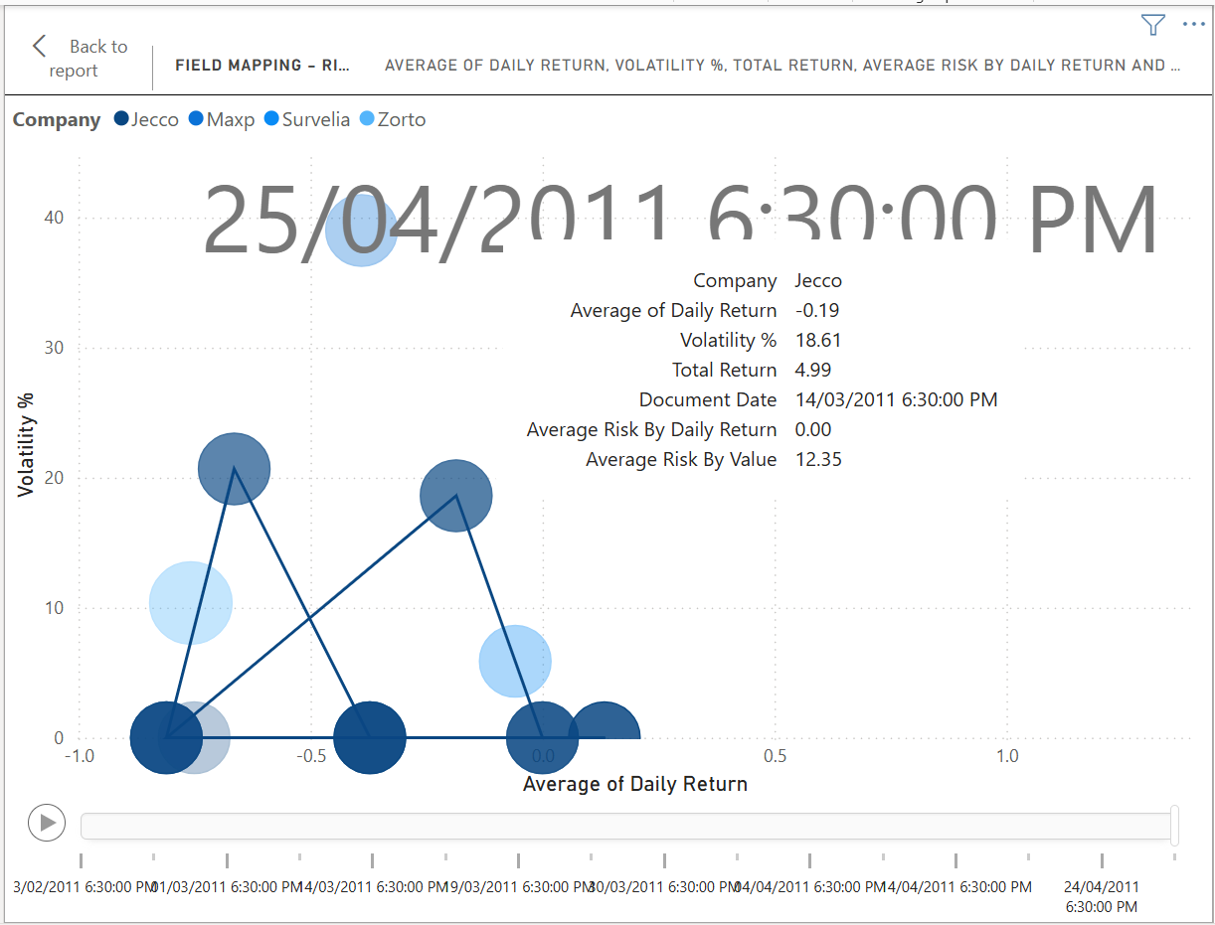

Slide 11
Stock Share Comparison
Title:
Stock Value Share by Company
Chart:
Donut
Chart Insight:
Shows portfolio distribution by total stock value
Highlights dominant vs. underperforming companies

Slide 12
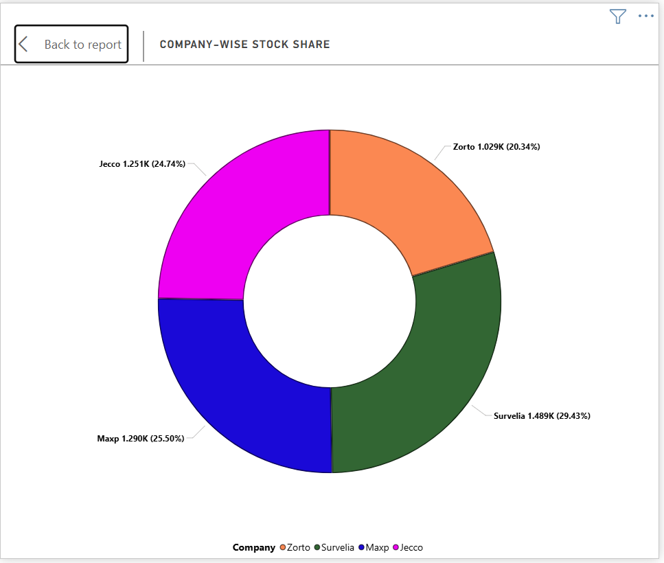

Slide 13
Company Deep Dive
Title :
Company Analysis Overview
Charts :
Clustered Bar Chart – Compare KPIs by company
Waterfall Chart – Change in stock value or return

Slide 14
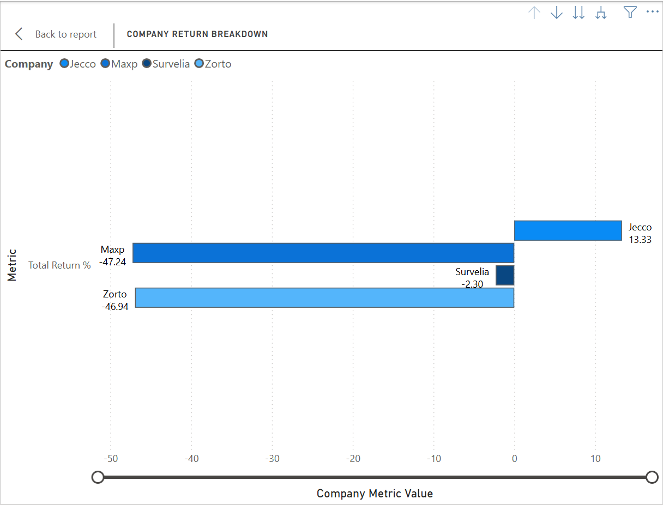

Slide 15
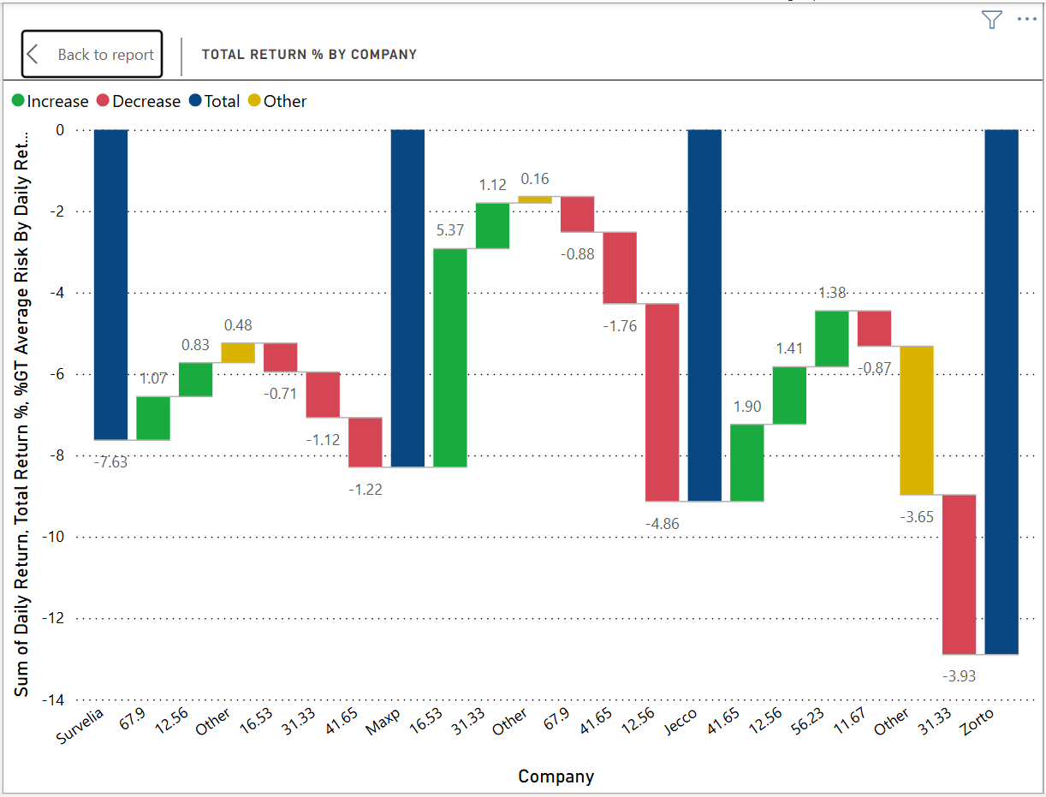

Slide 16
Company Decomposition
Title :
Company-wise Performance Breakdown
Chart :
Decomposition Tree
Breakdown by Company > Date or Risk
Insight :
Interactive analysis of factors driving performance

Slide 17
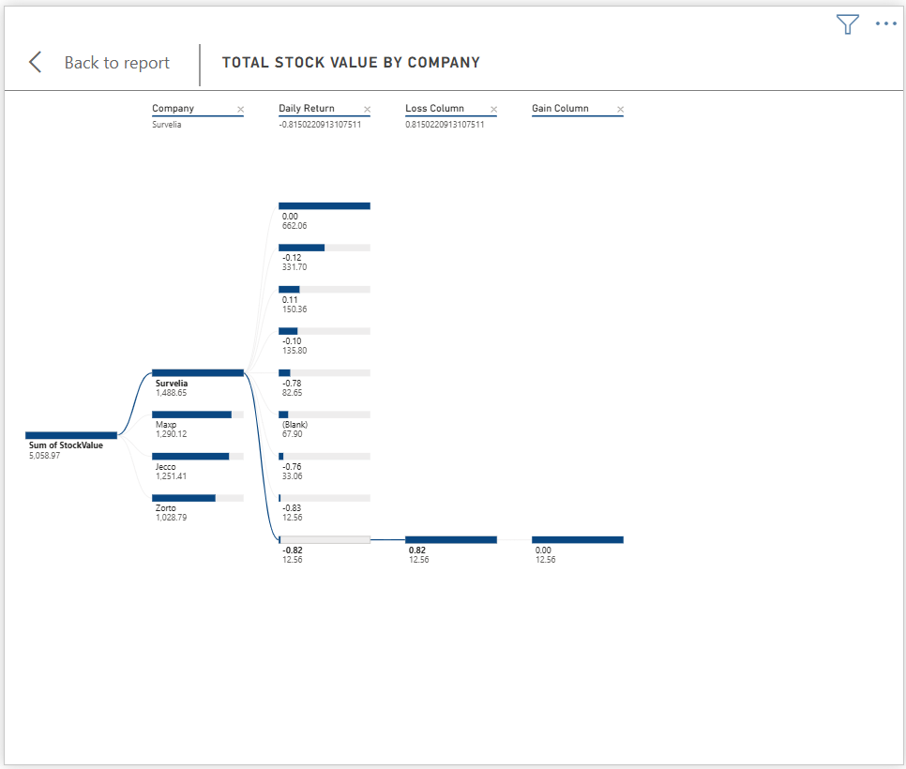

Slide 18
Key Influencers
Title :
Key Factors Driving Return
Charts :
Key Influencer Visual
Insight :
Identifies features most impacting total return
Uses AI-based model for decision impact

Slide 19
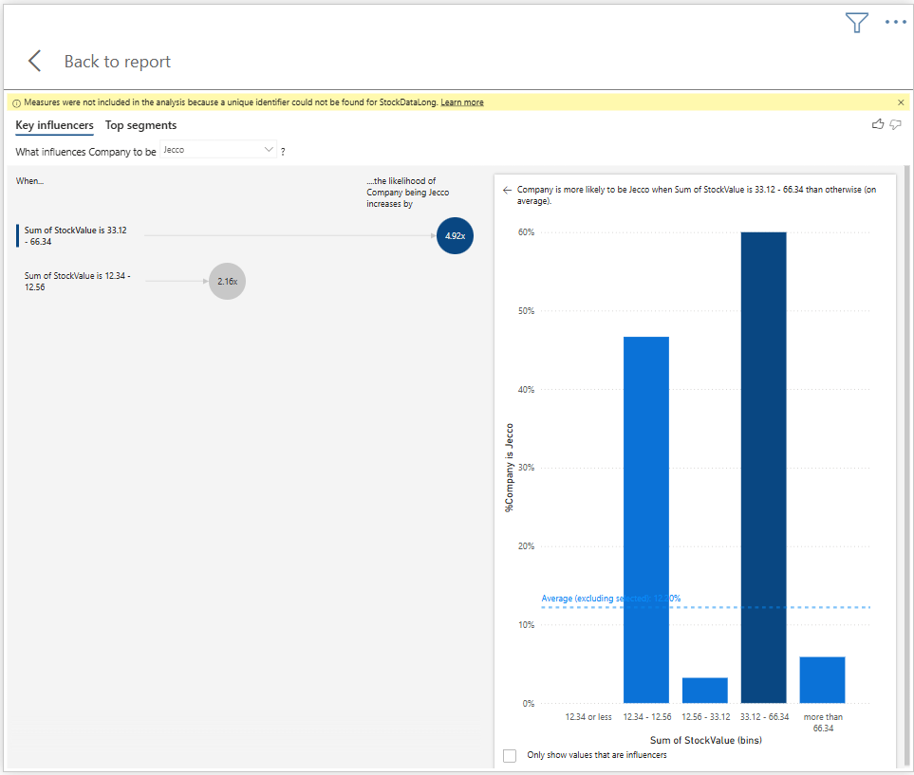

Slide 20
Technical Indicators
Title :
Technical Indicators – Moving Avg & Volatility
Charts :
Line Chart – 14-day Moving Average vs. Actual Price
Line Chart – 14-day Volatility (Standard Deviation)
Insight :
Helps detect trend reversals or stability
Volatility signals market risk level

Slide 21
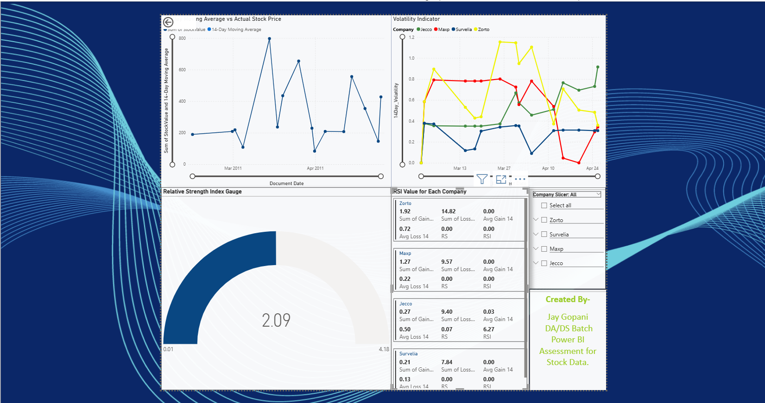

Slide 22
RSI or MACD
Title :
Momentum Indicator – RSI
Chart :
Line or Custom Visual
Based on calculated RSI values over 14 days
Insight :
Indicates overbought/oversold status
Supports trading signals and timing

Slide 23
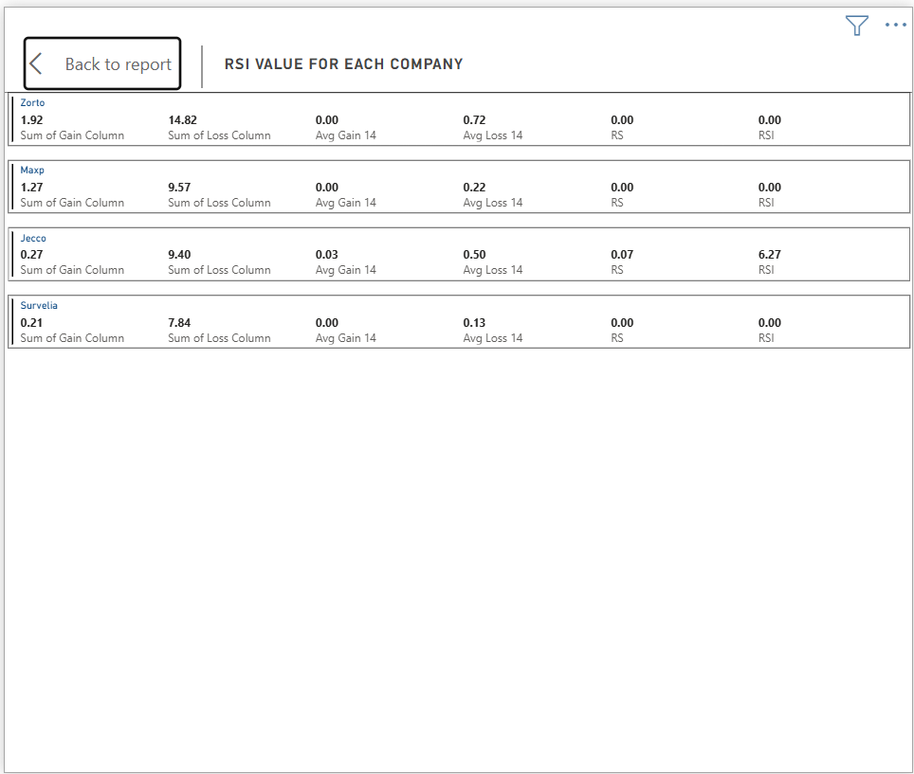

Slide 24
Slicers and Interactivity
Title :
Slicers and Interactivity
Content :
Company slicer (global filter across all pages)
Date-based filtering
Dynamic visuals adjust based on selections

Slide 25
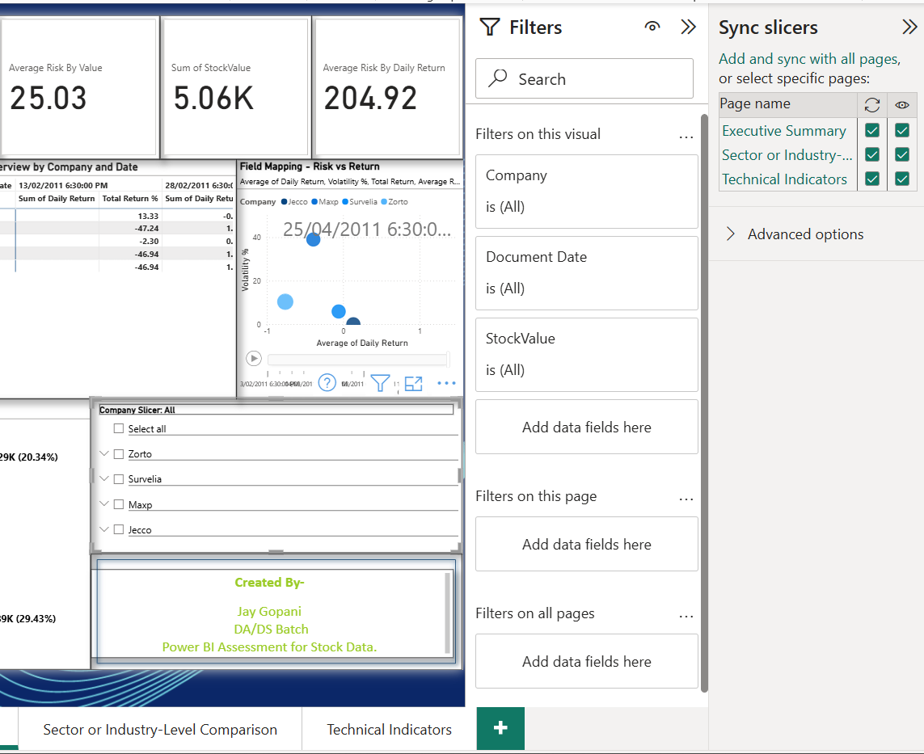

Slide 26
Conclusion & Next Steps
Title :
Insights and Recommendations
Bullet Points :
Continue monitoring stock volatility and return patterns
Consider risk-adjusted return for investment decisions
Enhance model with fundamental data or sector comparison
Use forecasting tools for future projections

Slide 27
Appendix
Title :
Appendix – Data Source & Model Info
Content :
Source: StockDataLong (Power BI model)
Measures used: Total Return %, Avg Risk, Daily Return, etc.
Visual Types: Line, Scatter, Donut, Decomposition Tree, Waterfall
Executive Report.docx

Slide 28
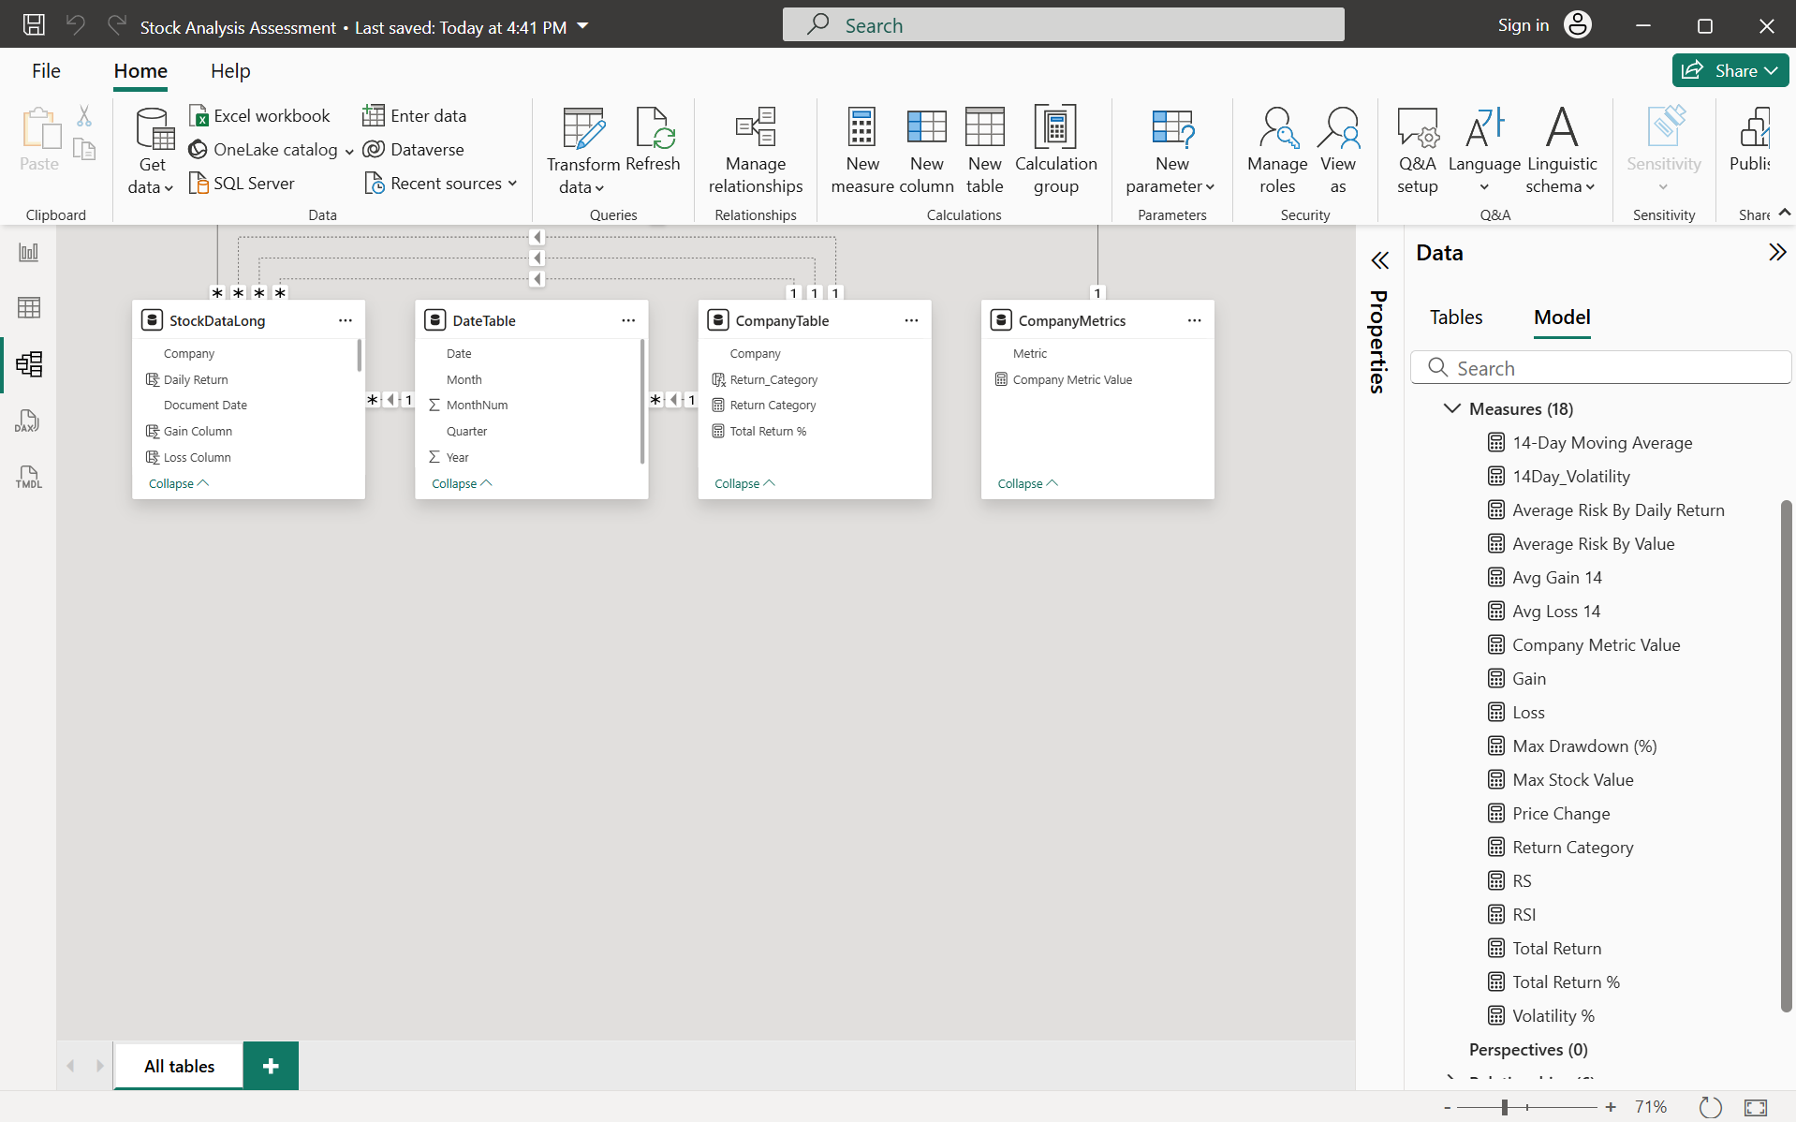

Slide 29
Thank You

